Slide 1
Scrum-Agile Development at ChadaTech
Lessons Learned from the SNHU Travel Project
Domenic Ferraro
CS 250 Software Development Lifecycle
June 2026

Slide 2
Scrum Team Roles
Product Owner
Defines product vision
Prioritizes product backlog
Represents stakeholders
Scrum Master
Facilitates Scrum events
Removes impediments
Promotes Agile practices
Developer
Builds application features
Collaborates with team members
Delivers working software
Tester
Creates and executes test cases
Validates acceptance criteria
Identifies defects and quality risks
Why These Roles Matter
Promotes accountability
Improve collaboration
Deliver customer value
Notes:
The Scrum framework relies on clearly defined roles. During this project, I experienced several of these roles firsthand. As Product Owner, I focused on gathering stakeholder feedback and creating user stories. As Scrum Master, I facilitated Scrum activities and helped maintain team focus. As Developer, I implemented features and adapted to changing requirements. As Tester, I created test cases and verified that functionality met acceptance criteria. Together, these roles ensured the project remained aligned with customer needs while maintaining quality and productivity.

Slide 3
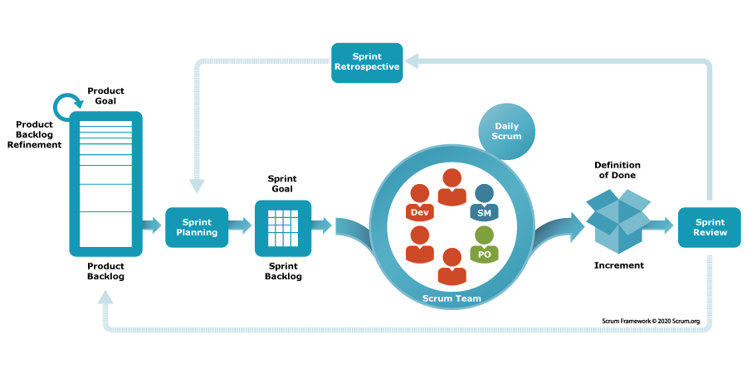
Agile SDLC Phases
Requirements Gathering
User stories
Stakeholder feedback
Sprint Planning
Select spring work
Establish sprint goals
Development
Build features incrementally
Testing
Continuous validation
Acceptance criteria verification
Sprint Review
Demonstrate completed work
Gather Stakeholder feedback
Sprint Retrospective
Evaluate performance
Identify improvements
Notes:
Unlike traditional development models, Agile repeats these phases throughout the project. Requirements are gathered through stakeholder collaboration and translated into user stories. Sprint Planning determines what work will be completed during a sprint. Development and testing occur continuously rather than as separate phases. Sprint Reviews allow stakeholders to evaluate progress, while Retrospectives help teams improve their processes. This iterative cycle supports flexibility and continuous improvement.

Slide 4
Scrum Events and Organizational Tools
Scrum Events
Sprint Planning
Daily Scrum
Backlog Refinement
Sprint Review
Sprint Retrospective
Agile Tools
Product Backlog
JIRA
Task Boards
Burndown Charts
Benefits
Transparency
Accountability
Improved organization
Better collaboration
Notes:
Several Scrum events helped organize work throughout the project. Sprint Planning established goals, Daily Scrums tracked progress, Backlog Refinement prepared future work, Sprint Reviews gathered feedback, and Retrospectives supported continuous improvement. Agile tools such as JIRA, task boards, and burndown charts provided visibility into project status. These tools helped the team stay organized and communicate effectively throughout development.

Slide 5
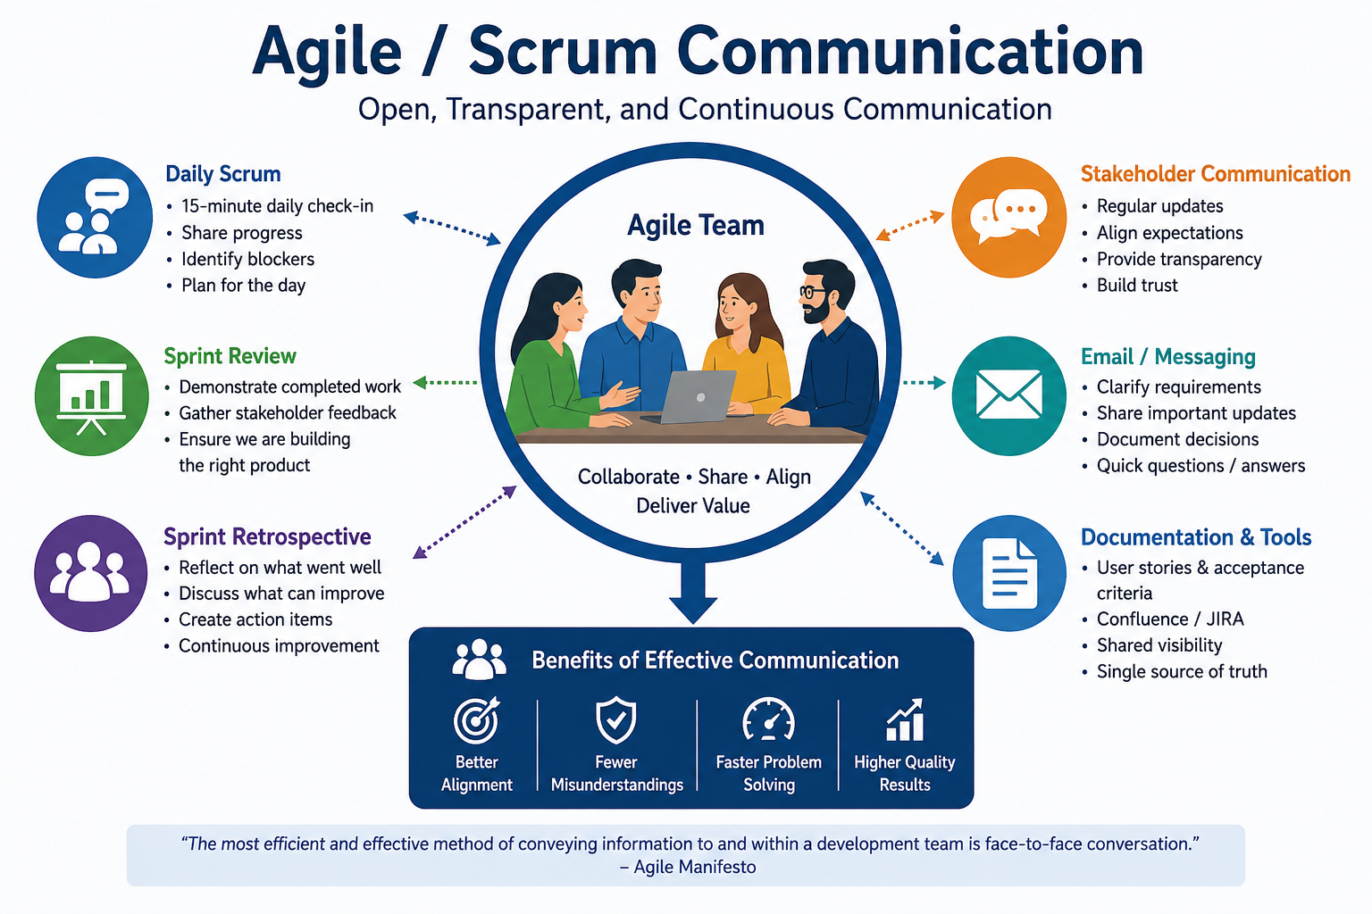
Communication in Agile Teams
Communication Methods
Daily Scrum meetings
Sprint Reviews
Stakeholder discussions
Email communication
Examples From SNHU Travel
Tester clarification email
Wellness travel update request
Daily progress discussions
Benefits
Reduces misunderstandings
Improves teamwork
Supports transparency
Accelerates problem solving
Notes:
Communication was one of the most important factors in project success. As a Tester, I communicated with the Product Owner to clarify business rules and testing requirements. Later, as a Developer, I requested updated priorities and requirements after the project shifted toward wellness travel. Daily Scrum meetings also helped team members share progress and identify obstacles. These communication practices promoted transparency and collaboration throughout the project.

Slide 6
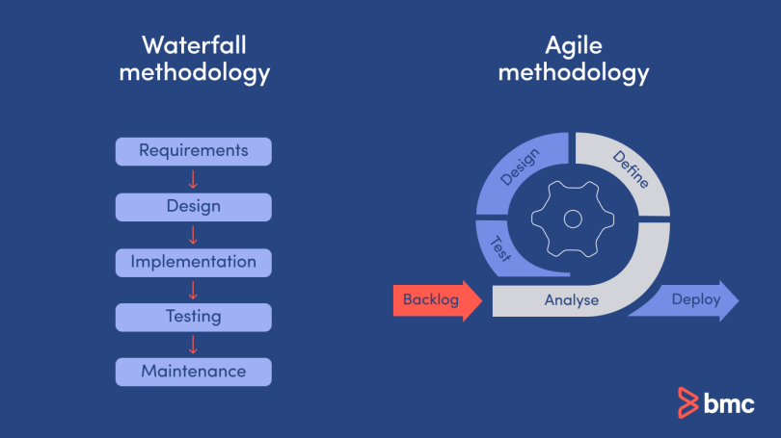
Waterfall vs. Agile Development
Waterfall
Sequential process
Fixed requirements
Testing occurs late
Difficult to change direction
Agile
Iterative development
Flexible requirements
Continuous testing
Frequent stakeholder feedback
SNHU Travel Example
Shifted to wellness travel
Agile allowed backlog reprioritization
Existing work remained valuable
Notes:
One major difference between Waterfall and Agile is the ability to respond to change. During the SNHU Travel project, the Product Owner shifted the focus toward detox and wellness travel. Using Agile, the team reprioritized the backlog and updated user stories without restarting development. In a Waterfall environment, this change would likely have required significant rework and schedule delays. Agile's flexibility made it better suited for this project.

Slide 7
Waterfall or Agile?
Choose Agile
When requirements may change
When stakeholder feedback is important
When incremental delivery is valuable
Choose Waterfall
When requirements are stable
When scope is clearly defined
When extensive documentation is required
SNHU Travel Conclusion
Requirements evolved
Stakeholder feedback was ongoing
Agile was the preferred approach
Notes:
Organizations should select a development methodology based on project characteristics. Agile works best when requirements are likely to change and customer feedback is important. Waterfall is more effective when requirements are stable and highly documented. Based on my experience with the SNHU Travel project, Agile was the better choice because customer needs evolved throughout development and the project required flexibility.

Slide 8
References
Agile Alliance. (n.d.). 12 principles behind the Agile Manifesto. https://agilealliance.org/agile101/12-principles-behind-the-agile-manifesto/
Atlassian. (2025). Agile project management. https://www.atlassian.com/agile
Project Management Institute. (2025). Disciplined Agile resources. https://www.pmi.org/disciplined-agile
Schwaber, K., & Sutherland, J. (2020). The Scrum Guide. https://scrumguides.org
Beck, K., Beedle, M., van Bennekum, A., Cockburn, A., Cunningham, W., Fowler, M., Grenning, J., Highsmith, J., Hunt, A., Jeffries, R., Kern, J., Marick, B., Martin, R. C., Mellor, S., Schwaber, K., Sutherland, J., & Thomas, D. (2001). Manifesto for Agile Software Development. https://agilemanifesto.org

